Slide 1






Neural
Mavericks
AI in Retail: Items Category Prediction
CAU Challenge
23rd May, 2024

Slide 2



Table of contents
Description of the task
Data analysis
Our Solution
Economic effect
01
02
03
04

Slide 3


Description of the Task
What problem are we solving?
develop machine learning model that can accurately predict the category of the products based on their titles, descriptions, and images.
What should we pay attention to first when making a decision
Analyzing the training data
determining whether the dataset is balanced (equal distribution)
identifying outliers
What naunces are there in the problem?
missing of some images in the dataset

Slide 4

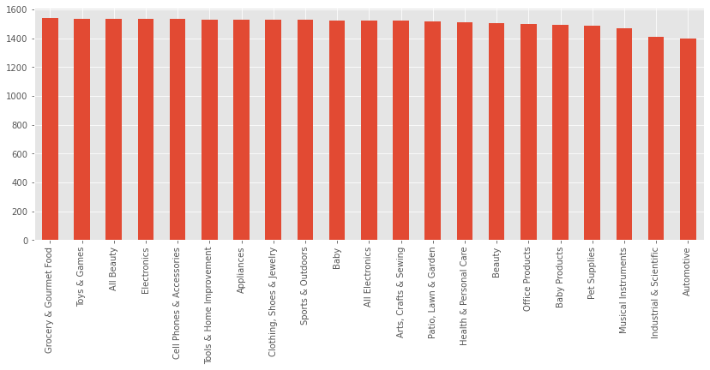
Data analysis
Class distributions

Slide 5

Images
Train
Test
2871 missing images
1265 missing images
~9% of the train data
~9.3% of the test data

Slide 6
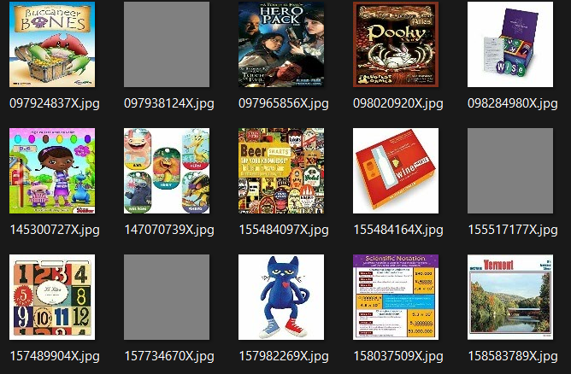
Placeholders

Slide 7
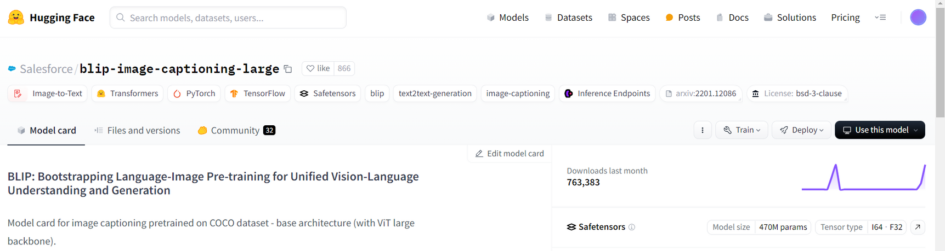
Image Captioning

Slide 8
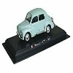

Image Captioning
a small toy car is on a black display stand
there is a man that is standing on a surfboard in the water [heh, really?]
replaced with “<PLACEHOLDER>”

Slide 9
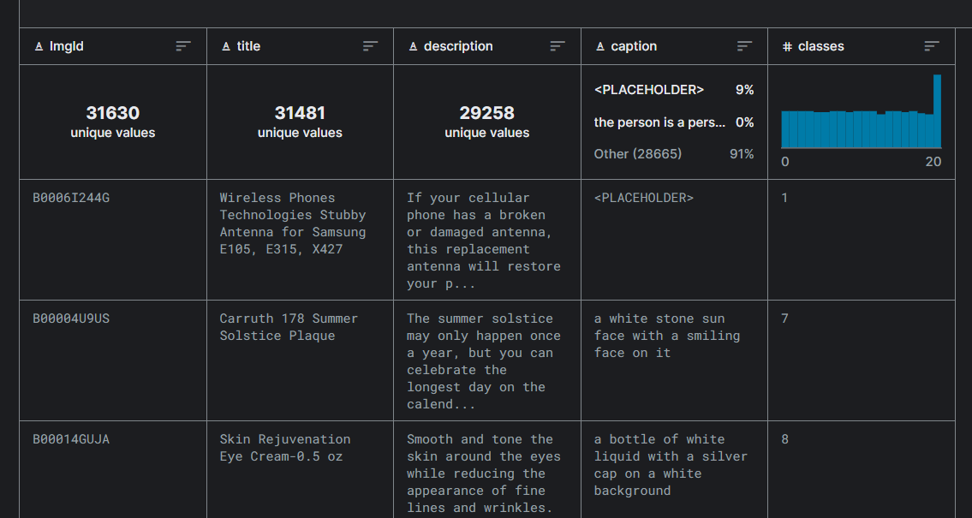

Slide 10


Our Solution
Models
Naive Bayes
XGBoost
Logistic Regression Vector Support Vector Machine (SVM)
0.744
0.736
0.774
0.785

Slide 11

Our Solution
Models (cont.)
DistilBert with nn
DistilBert
Bert
Bert with caption
0.815
0.832
0.836
0.847

Slide 12

The Best score: Ensemble - 0.856
Picking the most predicted class among 4 best scoring models

Slide 13



Economic effect
01
Improved Customer Experience
-> retailers can provide more relevant product recommendations to customers
02
Cost Savings
-> reduce manual labor costs associated with categorizing products, leading to cost savings for retailers.

Slide 14



Neural
Mavericks
Thank You!

